Slide 1
Chapter 15 - Processing Data
authored by Stephanie Fleischer © SAGE publications Ltd 2014

Slide 2
Topics covered
Part 1: Methods for processing data in quantitative research
Coding
Analysis
Part 2: Methods for processing data in qualitative researcher
Content analysis in qualitative research
Computers in research
authored by Stephanie Fleischer © SAGE publications Ltd 2014

Slide 3
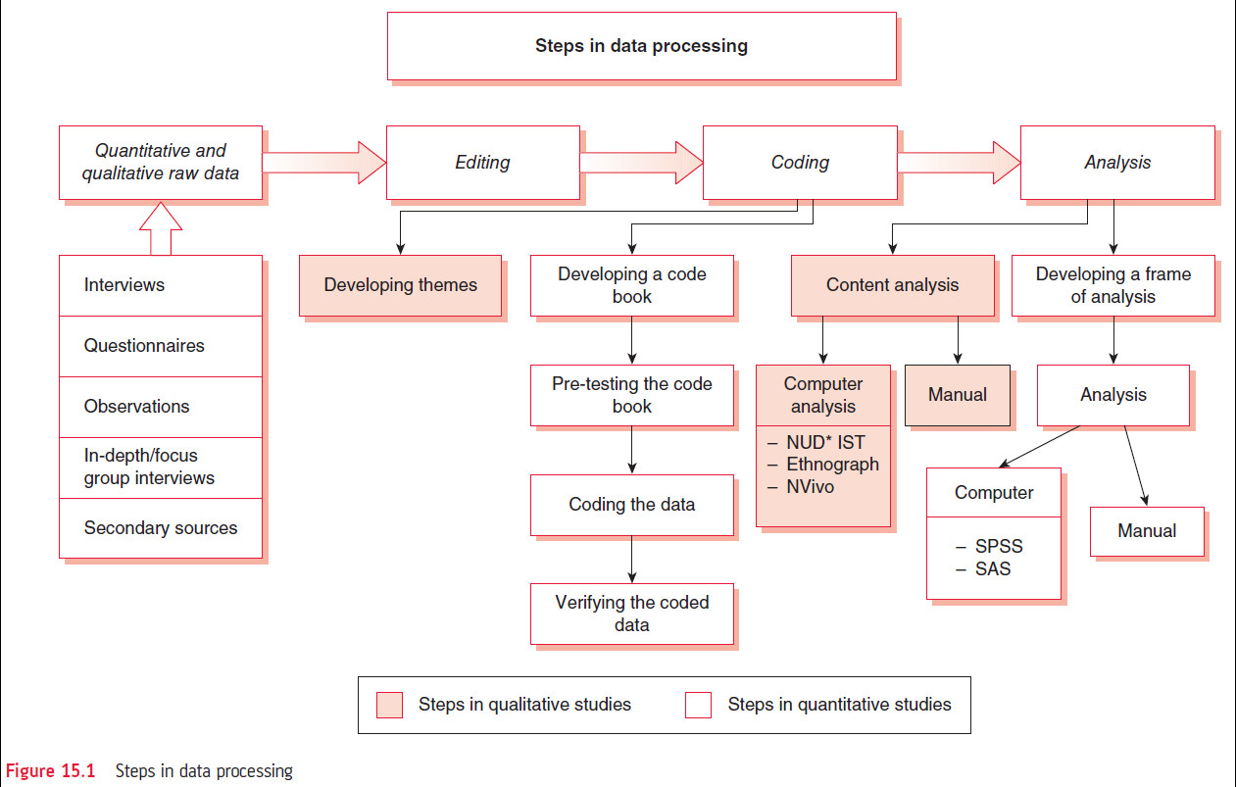
Figure 15.1 Steps in data processing
authored by Stephanie Fleischer © SAGE publications Ltd 2014

Slide 4
PART I: Methods for processing data in quantitative research
The raw data need to be edited or cleaned for analysis to check for completeness
Problems can be minimised by:
By inference
By recall
By going back to the respondents
Checking all answers to one question/variable
Checking all responses given to all questions by one respondents
authored by Stephanie Fleischer © SAGE publications Ltd 2014

Slide 5
Coding
The way a variable has been measured
Nominal
Ordinal
Ratio/interval
Numerical values will be used to describe the data
Quantitative (numerical) responses
Categorical responses
Descriptive responses
authored by Stephanie Fleischer © SAGE publications Ltd 2014

Slide 6
Steps of coding
Developing a code book
Pre-testing the code book
Coding the data
Verifying the coded data
authored by Stephanie Fleischer © SAGE publications Ltd 2014

Slide 7
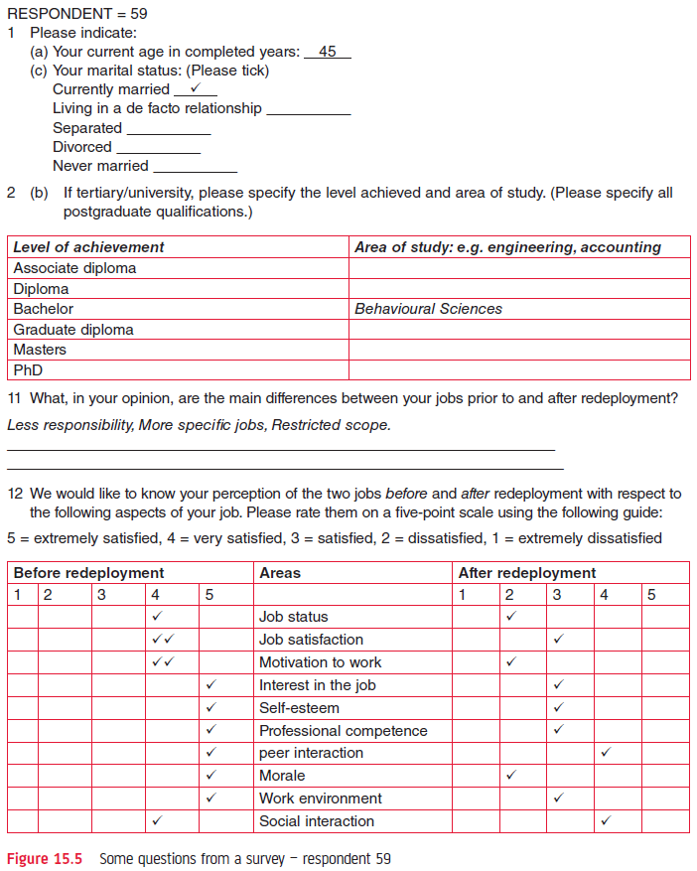
Figure 15.5 respondent 81
authored by Stephanie Fleisher © SAGE publications Ltd 2014
authored by Stephanie Fleischer © SAGE publications Ltd 2014

Slide 8
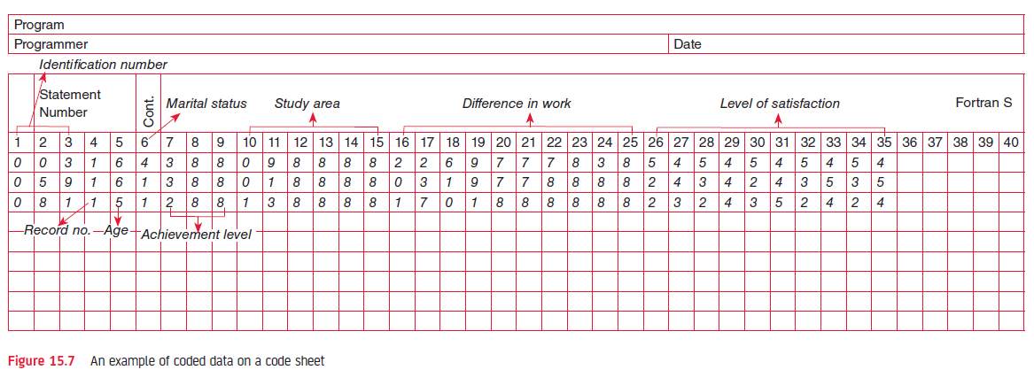
Fig. 15.7 An example of coded data on a code sheet
authored by Stephanie Fleischer © SAGE publications Ltd 2014

Slide 9
Analysing the data
Developing a frame of analysis
Analysing data manually or using a computer software: frequency distributions, percentages, means, etc.
Examining the relationship between variables
Other statistical procedures
Objectives of the study need to be addressed
authored by Stephanie Fleischer © SAGE publications Ltd 2014

Slide 10
PART II: Methods for processing data in qualitative research
Developing a narrative to describe the situation, episode, event or instance
Identify main themes that emerge from the field notes or transcriptions
In addition also quantify the frequency of occurrence of main themes in order to provide their prevalence
authored by Stephanie Fleischer © SAGE publications Ltd 2014

Slide 11
Content analysis in qualitative research
Process of content analysis:
Identifying the main themes
Assigning codes to the main themes
Classifying responses under the main themes
Integrating themes and responses into the text of the report
authored by Stephanie Fleischer © SAGE publications Ltd 2014

Slide 12
Computers in research
Statistical packages such as SPSS or SAS can help to organise numerical data and to understand it
Computers can help to aggregate and display data
Word processing is useful in qualitative research
ATLAS.ti and Nvivo software help to handle large volumes of written information
authored by Stephanie Fleischer © SAGE publications Ltd 2014

